Slide 1


Anti - Hypertensive Drugs
Mrs. Jagtap P.N
HOD of Pharmacology.
PDEA’S SGRS College of Pharmacy.

Slide 2
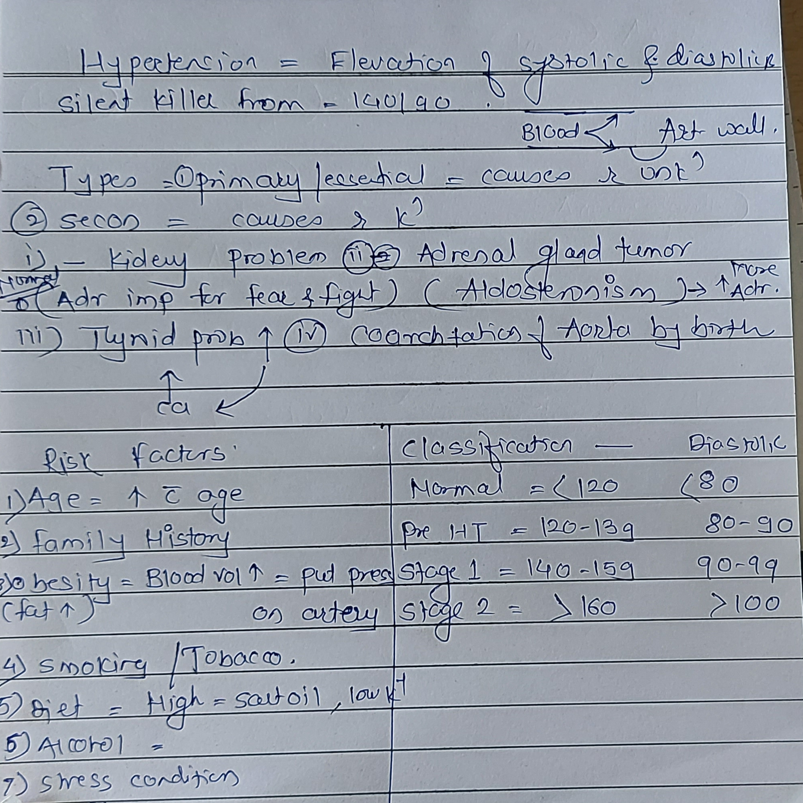

Slide 3
Mechanism of regulation of hypertension:
1.Baroreceptors
2. RAAS

Slide 4
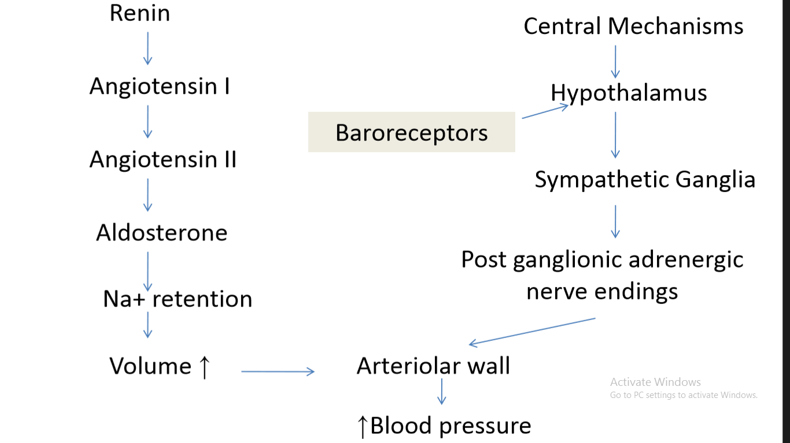
Physiology of hypertension

Slide 5
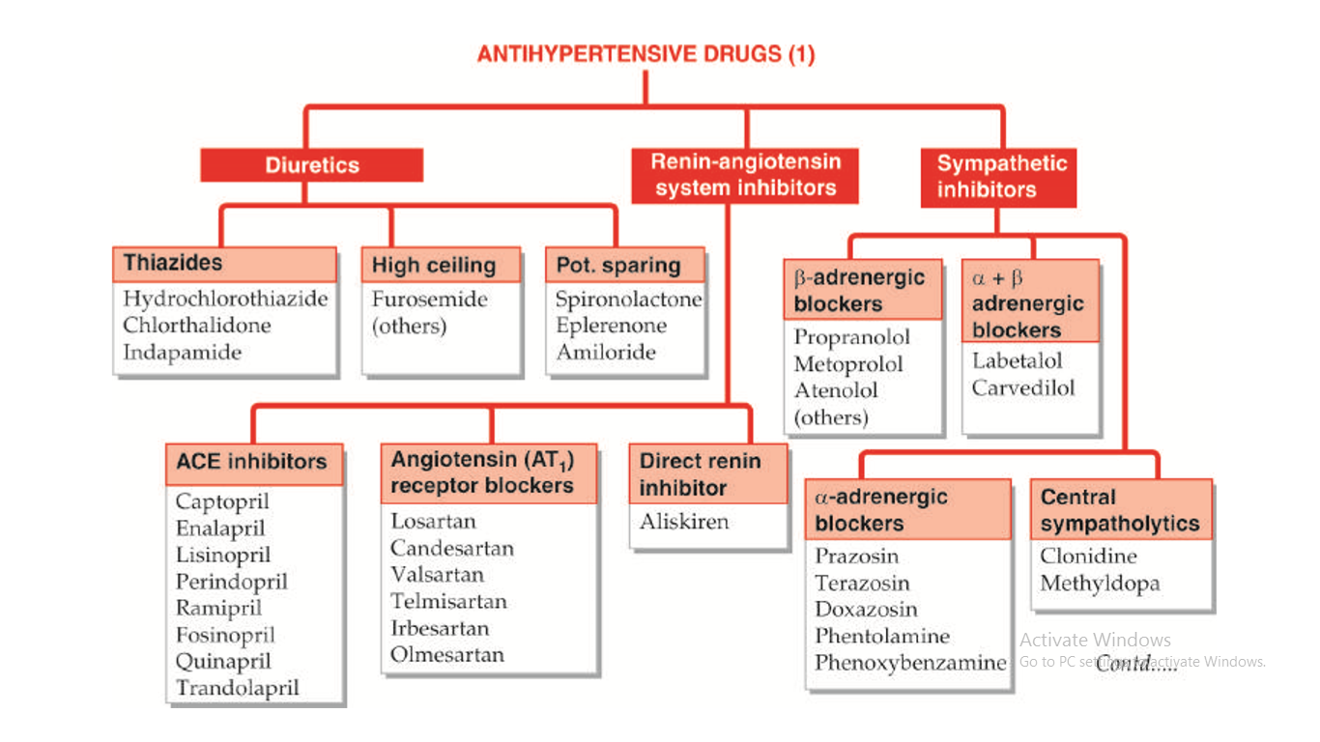
Classification of Anti- Hypertensive:

Slide 6
https://docs.google.com/forms/d/1iNVRzgFn_-KzABvOs4sD7jpW5fyNANkyltddL4Va0vQ/edit?usp=sharing

Slide 7
https://docs.google.com/forms/d/1WSfPbjwaC79u7qdU2unpwMrusIwMqLB6Xm01AII4jN4/edit?usp=sharing

Slide 8
Diuretics
Thiazide diuretics:
- Thiazide diuretics, such as hydrochlorothiazide and chlorthalidone, lower blood pressure initially by increasing sodium and water excretion. Thiazide diuretics can induce hypokalemia, hyperuricemia and, to a lesser extent, hyperglycemia in some patients.
Loop diuretics:
-Inhibitors of epithelial sodium transport at the late distal and collecting ducts (furosemide, and ethacrynic acid) or antagonizing aldosterone receptor (spironolactone, and eplerenone) and reduce potassium loss in the urine.

Slide 9
-Aldosterone antagonists have the additional benefit of diminishing the cardiac remodeling that occurs in heart failure.
-The loop diuretics act promptly by blocking sodium and chloride reabsorption in the kidneys, even in patients with poor renal function or those who have not responded to thiazide diuretics.
-Loop diuretics cause decreased renal vascular resistance and increased renal blood flow.
K+ Sparing:
- potassium-sparing diuretics (spironolactone, and eplerenone) are competitive antagonists that either compete with aldosterone, or directly block epithelial sodium channel (amiloride).

Slide 10
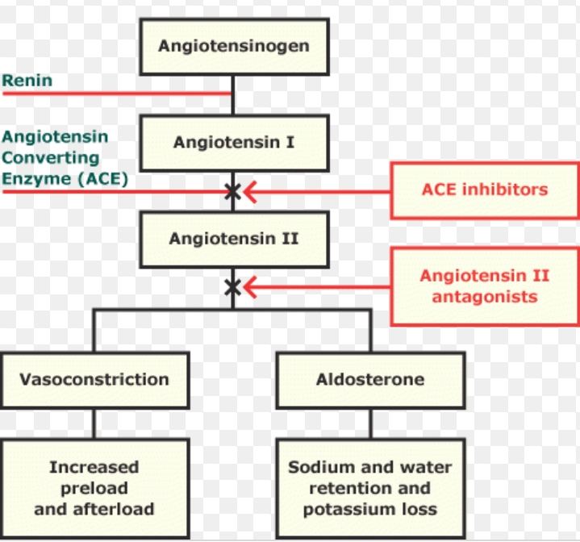

Slide 11
ACE inhibitors:
-The ACE inhibitors, are recommended as first-line treatment of hypertension in patients with a variety of compelling indications, including high coronary disease risk or history of diabetes, stroke, heart failure, myocardial infarction, or chronic kidney disease.
-ACE is also responsible for the breakdown of bradykinin, a peptide that increases the production of nitric oxide and prostacyclin by the blood vessels. Both nitric oxide and prostacyclin are potent vasodilators.

Slide 12
- ACE inhibitors decrease angiotensin II and increase bradykinin levels. Vasodilation is result of decreased vasoconstriction (from diminished levels of angiotensin II) and enhanced vasodilation (from increased bradykinin).
-By reducing circulating angiotensin II levels, ACE inhibitors also decrease the secretion of aldosterone, resulting in decreased sodium and water retention.
-ACE inhibitors reduce both cardiac preload and afterload, thereby decreasing cardiac work.

Slide 13
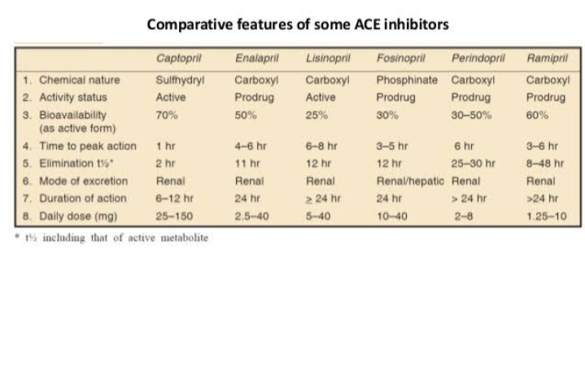

Slide 14
Adverse effects of ACE inhibitors:
• The adverse effect profile of all ACE inhibitors is similar. Captopril is well tolerated by most patients, especially if daily dose is kept below 150 mg.
• Hypotension: An initial sharp fall in BP occurs especially in diuretic treated and CHF patients
• Hyperkalaemia
• Cough
• Rashes, urticaria
• Angioedema

Slide 15
• Dysgeusia/ parageusia
• Foetopathic
• Headache, dizziness, nausea and bowel upset
• Granulocytopenia and proteinuria (rare ADR)
• Acute renal failure
Advantages of ACE inhibitor:
• Free of postural hypotension, electrolyte disturbances, feeling of weakness and CNS effects
• Safety in asthmatics, diabetics and peripheral vascular disease patients
• Long-term ACE inhibitor therapy has the potential to reduce incidence of type 2 diabetes in high risk subjects
• No rebound hypertension on withdrawal

Slide 16
Advantages of ACE inhibitor:
• No hyperuricaemia, no deleterious effect on plasma lipid profile
• ACE inhibitors are the most effective drugs for preventing sudden cardiac death in post-infarction patients. However, they are less effective for primary prophylaxis of MI and for preventing left ventricular hypertrophy.
Uses of ACE inhibitors
• Hypertension:
– The ACE inhibitors are first line drugs in all grades of hypertension, but the angiotensin receptor blockers (ARBs) have now surpassed them in popularity.
– Essential hypertension respond to monotherapy with ACE inhibitors and majority of the rest to their combination with diuretics or beta blockers

Slide 17
Uses of ACE inhibitors
• Congestive Heart Failure (CHF): ACE inhibitors cause both arteriolar and venodilatation in CHF patients; reduce afterload as well as preload.
• Myocardial infarction: Long-term ACE inhibitor therapy reduces recurrent MI.
• Prophylaxis in high cardiovascular risk subjects: ACE inhibitors are protective in high cardiovascular risk subjects even when there is no associated hypertension or left ventricular dysfunction. ACE inhibitors may improved endothelial function.

Slide 18
Uses of ACE inhibitors
• Diabetic nephropathy: Prolonged ACE inhibitor therapy has been found to prevent or delay endstage renal disease in type I as well as type II diabetics.
• Nondiabetic nephropathy: ACE inhibitors reducing proteinuria by decreasing pressure gradient across glomerular capillaries as well as by altering membrane permeability.
• Scleroderma crisis: The marked rise in BP and deterioration of renal function in scleroderma crisis is mediated by Ang II. ACE inhibitors produce improvement and are life saving in this condition.

Slide 19
Angiotensin antagonists (ARBs)
• Angiotensin antagonists: losartan, candesartan, valsartan, telmisartan, olmesartan and irbesartan.
• Their pharmacologic effects of ARBs are similar to those of ACE inhibitors.
• ARBs produce arteriolar and venous dilation and block aldosterone secretion, thus lowering blood pressure and decreasing salt and water retention.
• ARBs do not increase bradykinin levels
• ARBs may be used as first-line agents for the treatment of hypertension, especially in patients with a compelling indication of diabetes, heart failure, or chronic kidney disease.

Slide 20
Direct renin inhibitor
• A selective renin inhibitor, aliskiren directly inhibits renin and, thus, acts earlier in the renin– angiotensin–aldosterone system than ACE inhibitors or ARBs.
• It lowers blood pressure about as effectively as ARBs, ACE inhibitors, and thiazides. Aliskiren should not be routinely combined with an ACE inhibitor or ARBs.
• Aliskiren can cause diarrhea, especially at higher doses, and can also cause cough and angioedema, but probably less often than ACE inhibitors.
• Aliskiren is contraindicated during pregnancy.

Slide 21
β-adrenergic blockers
β-adrenergic blockers are mild antihypertensives and do not significantly lower BP in normotensives. In stage 1 cases of hypertensive patients (30 - 40%), β adrenergic blockers are used alone.
Propranolol
• Propranolol is a first β blocker showed effective in hypertension and ischemic heart disease.
• Propranolol has now been largely replaced by cardioselective β blockers such as metoprolol and atenolol.
• All β-adrenoceptor-blocking agents are useful for lowering blood pressure in mild to moderate hypertension.
• In severe hypertension, β blockers are especially useful in preventing the reflex tachycardia that often results from treatment with direct vasodilators.

Slide 22
Metoprolol & Atenolol
• Metoprolol and atenolol, which are cardioselective, are the most widely used β blockers in the treatment of hypertension.
• Metoprolol is atenolol is inhibiting stimulation of β1 adrenoceptors.
• Sustained-release metoprolol is effective in reducing mortality from heart failure and is particularly useful in patients with hypertension and heart failure.
• Atenolol is reported to be less effective than metoprolol in preventing the complications of hypertension.

Slide 23
Other beta blockers
• Nadolol and carteolol, nonselective β-receptor antagonists
• Betaxolol and bisoprolol are β1-selective blockers
• Pindolol, acebutolol, and penbutolol are partial agonists, ie, β blockers with some intrinsic sympathomimetic activity. These drugs are particularly beneficial for patients with bradyarrhythmias or peripheral vascular disease.
• Labetalol, Carvedilol, & Nebivolol have both βblocking and vasodilating effects.
• Esmolol is a β1-selective blocker that is rapidly metabolized via hydrolysis by red blood cell esterases. Esmolol is used for management of intraoperative and postoperative hypertension, and sometimes for hypertensive emergencies, particularly when hypertension is associated with tachycardia or when there is concern about toxicity such as aggravation of severe heart failure.

Slide 24
α Adrenergic blockers / Adr receptor blockers/ sympatholytics
These drugs inhibit adrenergic responses mediated through the α adrenergic receptors without affecting those mediated through β receptors

Slide 25
α1
Location: Post functional at effector organ
Functions: Smooth Muscle contraction
Gland: Secretions
Gut : Relaxed
Agonist: Phentolamine
Antagonist: Prazosine
α2
Location: Pre junctional at nerve ending Pancreatic beta cells, BV, Platelets
Functions:decresed transmitter release, vasocnstriction, Decresed central sympathetic flow
Agonist: Clonidine
Antagonist: Yohimbine

Slide 26
CLASSIFICATION
I. Nonequilibrium type
(i) β-Haloalkylamines—Phenoxybenzamine.
II. Equilibrium type (competitive)
A. Nonselective
(i) Ergot alkaloids—Ergotamine, Ergotoxine
(ii) Hydrogenated ergot alkaloids—Dihydroergotamine
(DHE), Dihydroergotoxine
(iii) Imidazolines—Tolazoline, Phentolamine
(iv) Miscellaneous–Chlorpromazine
B. α1 selective—Prazosin, Terazosin, Doxazosin,
Tamsulosin
C. α2 selective—Yohimbine

Slide 27
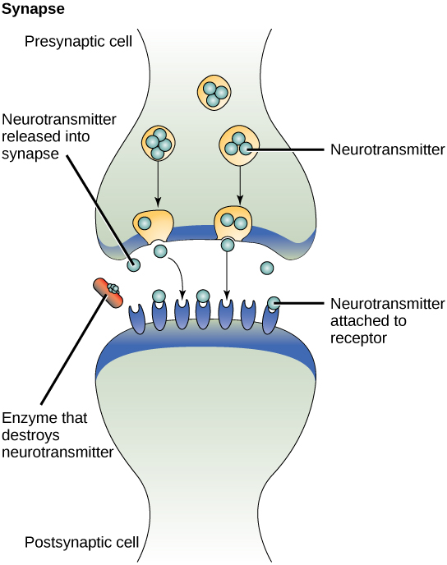

Slide 28
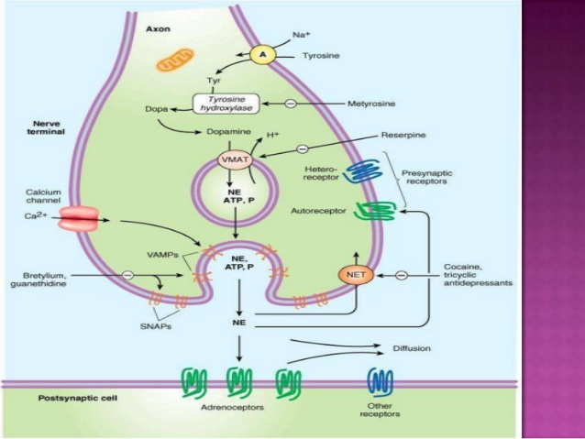

Slide 29
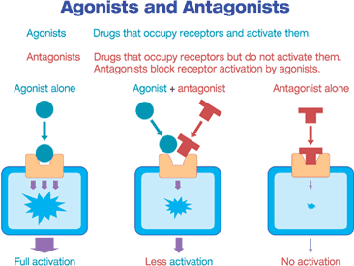

Slide 30
GENERAL EFFECTS OF α BLOCKERS
Vasodilators
Refelx tachycardia
Nasal Stiffness
Miosis
Increase intestinal motility
Decreases rebal blood flow
Tone of SM of Sphincter & Prostate
Prazosin is found to decreases LDL & TG increases HDL
Not affects
1. Adr cardiac Stimulation
2. Bronchodilation
3. Metabolic changes

Slide 31
Phenoxybenzamine
It cyclizes spontaneously in the body giving rise to a highly reactive ethyleniminium intermediate which reacts with α adrenoceptors and other biomolecules by forming strong covalent bonds. The α blockade develops gradually (even after i.v. injection) and lasts for 3–4 days.
The fall in BP caused by phenoxybenzamine is mainly postural because venodilatation is more prominent than arteriolar dilatation

Slide 32
Phenoxybenzamine is lipid soluble, penetrates brain and can produce CNS stimulation, nausea and vomiting on rapid i.v. injection. However, oral doses produce depression, tiredness and lethargy. Major side effects are postural hypotension, palpitation, nasal blockage, miosis.
Pharmacokinetics
Oral absorption is erratic and incomplete; i.m. and s.c.injections are very painful—should not be given. Though most of the administered dose is excreted in urine in 24 hours, small amounts that have covalently reacted remain in tissues

Slide 33
Natural and hydrogenated ergot alkaloids
Ergot alkaloids are the adrenergic antagonists with which Dale demonstrated the vasomotor reversal phenomenon. The amino acid alkaloids ergotamine and ergotoxine are partial agonists and antagonists at α adrenergic, serotonergic and dopaminergic receptors. The amine alkaloid ergometrine has no α blocking activity. The natural ergot alkaloids produce long lasting vasoconstriction which predominates over their α blocking action—peripheral vascular insufficiency and gangrene of toes and fingers occurs in ergotism.

Slide 34
Ergotoxine is a more potent α blocker and less potent vasoconstrictor than ergotamine. Hydrogenation reduces vasoconstrictor and increases α blocking activity. The α blockade produced by clinical doses of ergot alkaloids is low grade and short lasting; they are not employed for this purpose. The principal use is in migraine.Diagnostic use of ergotamine has been made to precipitate ECG signs of ischaemia in coronary artery disease. Dihydroergotoxine has been used as a cognition enhancer.

Slide 35
Tolazoline
It is an imidazoline compound with complex pharmacological properties.
The α blocking action is only modest and short lasting.
In addition, it is a direct vasodilator and stimulates the heart. Tolazoline also blocks 5-HT receptors, has a histamine like gastric secretagogue and ACh like motor action on intestines.
It was used in peripheral vascular diseases and pulmonary hypertension of the newborn.

Slide 36
Phentolamine
This congener of tolazoline is a rapidly acting α blocker with short duration of action (in minutes).
It equally blocks α1 and α2 receptors—NA release is increased and venodilatation predominates over arteriolar dilatation.
It is used as a quick and short acting α blocker for diagnosis and intraoperative management of pheochromocytoma and for control of hypertension due to clonidine withdrawal, cheese reaction, etc.
It is the most suitable α blocker for local infiltration to counteract vasoconstriction due to extravasated NA/DA during their i.v. infusion.

Slide 37
Prazosin
It is first of the highly selective α1 blockers.
All subtypes of α1 receptor (α1A, α1B, α1D) are blocked equally.
It blocks sympathetically mediated vasoconstriction and produces fall in BP which is attended by only mild tachycardia; NA release is not increased due to absence of α2 blockade.
Prazosin dilates arterioles more than veins. Postural hypotension is less marked, occurs especially in the beginning, which may cause dizziness and fainting as ‘first dose effect’.

Slide 38
This can be minimized by starting with a low dose and taking it at bedtime.
Subsequently tolerance develops to this side effect. Other α blocking side effects are also milder.
It also inhibits phosphodiesterase which degrades cAMP.
Rise in smooth muscle cAMP could contribute to its vasodilator action.
Prazosin is effective orally (bioavailability ~60%), highly bound to plasma proteins (mainly to α1 acid glycoprotein), metabolized in liver and excreted primarily in bile. Its plasma t½ is 2–3 hours; effect of a single dose lasts for 6–8 hours.

Slide 39
Terazosin
It is chemically and pharmacologically similar to prazosin; differences are higher bioavailability (90%) and longer plasma t½ (~12 hr); a single daily dose lowers BP over 24 hrs.
Terazosin is more popular for use in BHP due to single daily dose Doxazosin
Another long acting (t½ 18 hr) congener of prazosin with similar pharmacological profile, used in hypertension and BHP.

Slide 40
Tamsulosin
This uroselective α1A/α1D blocker has been found as effective as terazosin in improving BHP symptoms.
Because α1A subtype predominate in the bladder base and prostate, while α1B receptors are dominant in blood vessels, tamsulosin does not cause significant changes in BP or HR at doses which relieve urinary symptoms.
No increase in adverse cardiovascular events, including postural hypotension has been noted. Dizziness only significant side effect.
Its plasma t½ is 6–9 hrs, but the modified release (MR) cap needs only once daily dosing. It appears to be a better tolerated α1 blocker for BHP.

Slide 41
Yohimbine
A n alkaloid from West African plant Yohimbehe.
It is a relatively selective α2 blocker with short duration of action.
Also blocks 5-HT receptors.
Heart rate and BP are generally elevated due to increased central sympathetic outflow as well as peripheral NA release. Other CNS effects include excitation, tremor, ADH release (antidiuresis), nausea and vomiting.
This effect is only psychological, but can overcome psychogenic impotence in some patients. There are no valid indications for clinical use of yohimbine.
Chlorpromazine α adrenergic blocking activity—cause fall in BP, nasal stuffiness and inhibition of ejaculation as side effect

Slide 42
Uses:
Pheochromocytoma
Hypertension
Benign hypertrophy of prostate (BHP)
Peripheral vascular diseases
Congestive heart failure (CHF)

Slide 43
Centrally acting adrenergic drugs
Clonidine
• Clonidine acts centrally as an α2 agonist to produce inhibition of sympathetic vasomotor centers, decreasing sympathetic outflow to the periphery. This leads to reduced total peripheral resistance and decreased blood pressure. At present, it is occasionally used in combination with a diuretic.
Methyldopa
• It is an α2 agonist that is converted to methylnorepinephrine centrally to diminish adrenergic outflow from the CNS. It is mainly used for management of hypertension in pregnancy, where it has a record of safety.

Slide 44
Vasodilators
• Hydralazine/Dihydralazine and minoxidil not used as primary drugs to treat hypertension. These vasodilators act by producing relaxation of vascular smooth muscle, primarily in arteries and arterioles. This results in decreased peripheral resistance.
• Both agents produce reflex stimulation of the heart, resulting in the competing reflexes of increased myocardial contractility, heart rate, and oxygen consumption.
• Hydralazine is an accepted medication for controlling blood pressure in pregnancy induced hypertension. This drug is used topically to treat male pattern baldness.

Slide 45
Treatment of hypertension
Hypertensive emergency:
• It is rare but lifethreatening condition (systolic BP >180 mm Hg or diastolic BP >120 mm Hg with evidence of impending or progressive target organ damage such as stroke, myocardial infarction).
• A variety of medications are used, including calcium channel blockers (nicardipine and clevidipine), nitric oxide vasodilators (nitroprusside and nitroglycerin), adrenergic receptor antagonists (phentolamine, esmolol, and labetalol), the vasodilator hydralazine, and the dopamine agonist fenoldopam.

Slide 46
Resistant hypertension:
It is defined as blood pressure that remains elevated despite administration of an optimal three-drug regimen that includes a diuretic.
The most common causes of resistant hypertension
– poor compliance
– excessive ethanol intake
– concomitant conditions (diabetes, obesity, sleep apnea, hyperaldosteronism, high salt intake, metabolic syndrome)
– concomitant medications (sympathomimetics, nonsteroidal anti-inflammatory drugs, or antidepressant medications)
– insufficient dose/ drug

Slide 47
References:-
www.slideshare.com, ppt on Anti-hypertensive drugs, by S. Parasuraman.
www.slideshare.com, ppt on Anti-hypertensive drugs.
K.D. Tripathi.

